Slide 1
Springboard Modelling Project

Slide 2
What did we accomplish?
Sourced two datasets
Apple and Google app data
Data cleaning, transformation, and visualization
Added new descriptive columns to each dataset and then joined them together
Removed missing values
Summarized data
Data modelling
Finding how the data is distributed

Slide 3
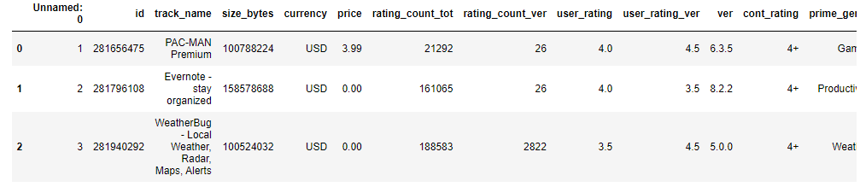
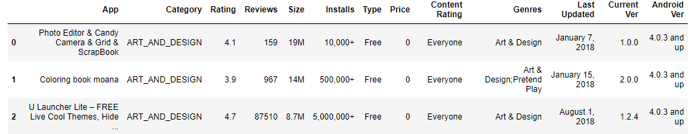
Data Sourcing
Sourced and printed raw Apple Data
Sourced and printed raw Google Data

Slide 4
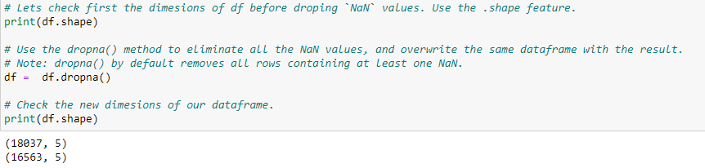
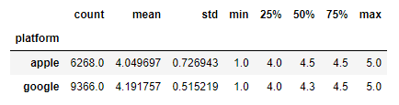
Data Cleaning and Transformation
We set the column names of the two datasets to be the same so that we could append the datasets to each other for analysis
Once the dataframes were merged, we removed NaN values so that we could more easily analyze the data
We performed a basic statistical analysis to look at the IQR of ratings for the apps by platform

Slide 5
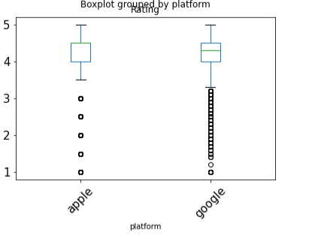
Data Cleaning and Transformation
In order to be able to better understand the data and how the ratings are distributed, it was printed to a box and whisker plot to show where the majority of the observations were as well as the distribution of outliers

Slide 6
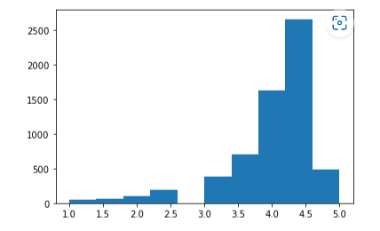
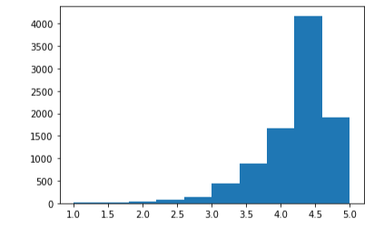
Data modeling
Using the Histogram call in matplotlib.pyplot, we were able to see the distribution of ratings for both Apple apps (shown on top) and Google apps (shown on bottom). The distribution is not normal, with both apps averaging around a 4 star rating. There were a few lower rated ones which resulted in the left tail for both platforms.

Slide 7
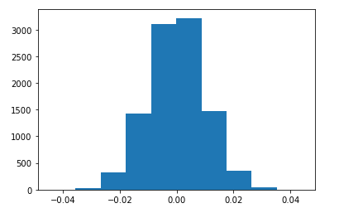
Data modeling
Because the data was not normally distributed, we used a non-parametric test to analyze it. The observed difference in ratings between the two apps was also calculated (the difference in mean rating for apple and mean rating for google) which was found to be 0.1421.

